Slide 1
FOUNDATION-LINUX

Slide 2
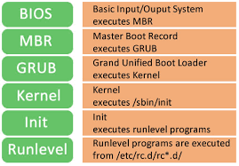
Booting Process
BIOS
Basic Input/Output System executes MBR
MBR
Master Boot Record
Executes GRUB
GRUB
Grand Unified Boot Loader
Executes kernel
KERNEL
Kernel executes /sbin/init
Init
Init executes runlevel programs
Runlevel
Runlevel programs are executed from /etc/rc.d/rc*.d/

Slide 3
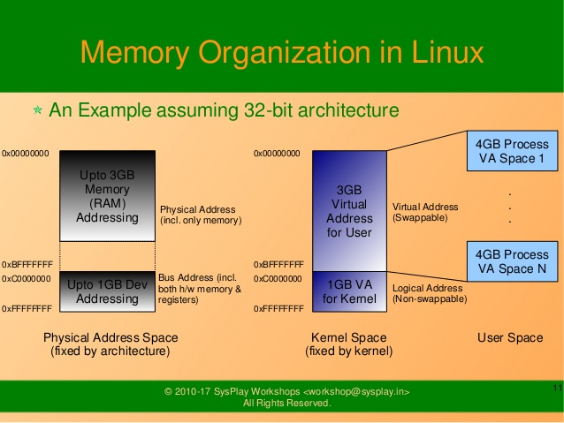

Slide 4
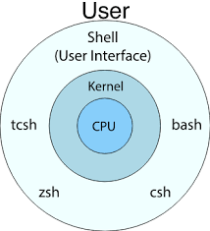
Shell

Slide 5
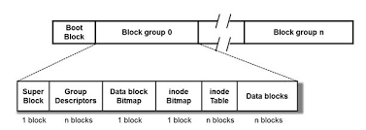
FILE SYSTEM
File System
Ext 2
Ext 3
Ext 4
Types of Journaling
Write back
Ordered
Data

Slide 6
PROCESS MANAGEMENT
TYPES OF PROCESS SCHEDULING
FCFS (First Come First Serve)
SJF (Shortest Job First)
Round Robin Priority Scheduling.
Types of Processes:
Init Process
Parent Process
Child Process
Zombie Process
Orphan Process
Interactive Process
Daemon Process
Real-time Process

Slide 7
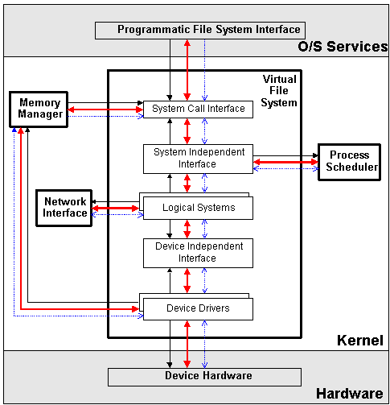
Kernel

